Slide 1
A ‘True Storytelling’ about Prostate Cancer
David Michael Boje
https://enthinkment.com

Slide 2
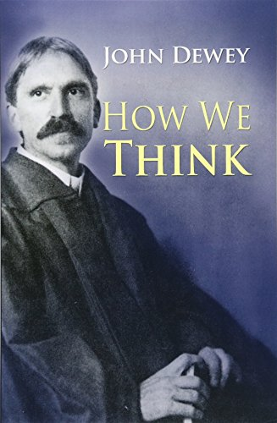
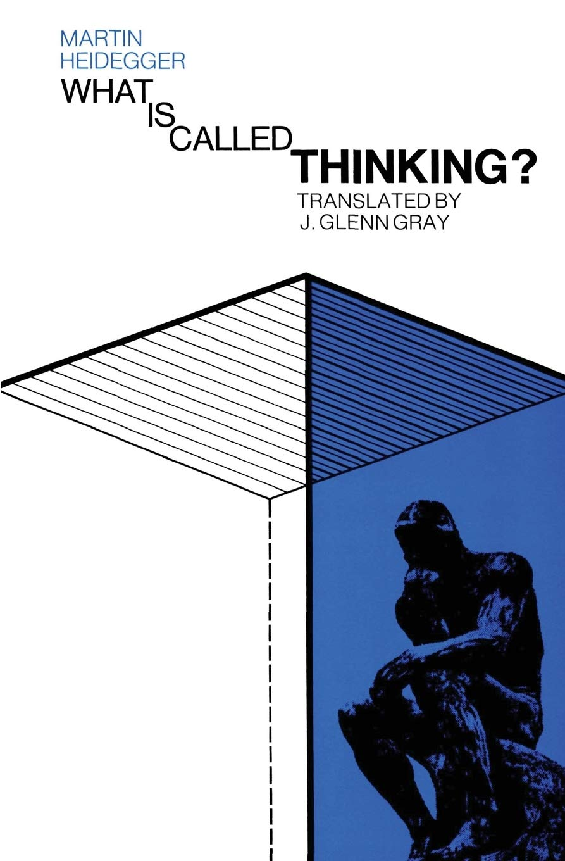
These slides are about my own ‘true storytelling’ journey as I enter the prostate adventure and I am learning how to think about a taboo topic: Prostate Cancer.
How we think about Prostate Cancer, affects our Enthinkment about getting aware of options
Prostate cancer is not something we think about, then it happens, and its all we think about.

Slide 3
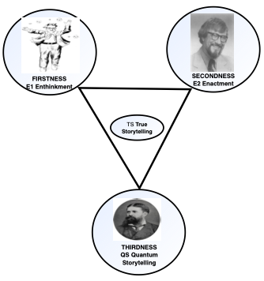
I am making sense of my own prostate cancer with E1 Pondy, how to think about it; E2 Weick it’s enactment sensemaking; and QS, the quantum storytelling of Charles Sanders Peirce
I will elaborate this in what follows

Slide 4
My Mentor Louis Ralph Pondy, invited me to think differently and like Dewey (1910), trained me in ‘How to Think’ something outside of five senses. Pondy, the Leaping Thinker, died at age 49 before I could ask “What is Called Thinking” (Heidegger)?
Pondy and I wanted to ‘Bring Mind Back’ into Weick’s ‘enactment-sensemaking, which has the motto: Enactment not Enthinkment.
The Quantum Storytelling changes how we do acts of Enthinkment and Enactment. For Horkheimer and Adorno, Enlightenment Thinking changed How We Think, by Disenchantment & Deymythologizing, in order to progress Domination of Nature.
John Dewey (1929) inspired by Quantum Physics, took an ontological turn to Think Differently.
Slavoj Žižek combines psychoanalytic with Hegel, to ask for a dialectic in Barad’s (2007) intra-activity of materiality with discourse (aka, agential realism) which has no dialectic, and is the neither-nor.
We ask what’s the ‘true storytelling’ in all this?

Slide 5
To the Point of Enthinkment Circle
What to do about prostate cancer? How to think about it? What is the thinking about it? I follow John Dewey, that more is going on than the five senses of sensemaking enactment can comprehend.
I look to quantum storytelling (QS) for how it changes how to think about prostate cancer and what sense to make of it by my senses.
Here is the thing, the Enlightenment Thinking had Disenchanted life, while bringing in medical technologies. I am a shamanic practitioner, a myth-maker, a ‘spirit seer’. Enlightenment combines with the Culture Industry to disenchant Nature, Shamans, and natural approaches. The claim is its progress over myth, but does medicine examine critically its own myth-making?
Several kinds of Quantum Physics are contending: (1) Dewey (1929) followed Heisenberg’s Principle of Indeterminacy, (2) Barad (2007) followed Neils Bohr, (3) Žižek (2014) wants to bring the dialectic back in; (4) Horkheimer & Adorno (1940) concludes the dialectic after disenchantment is not the same anymore.

Slide 6
To the Point of Enthinkment Circle is to study all of the triadic including what’s true.
In other words, prostate cancer once a part of nature, treated by the shaman, not in the age of Enlightenment, its treated by medical technology, and the Culture Industry has its own way of thinking and making sense of prostate cancer. Horkheimer calls all this a phantasmagoria, meaning you can not think away or enact away, psychoanalytic role in Quantum Storytelling.
What’s true storytelling? The return of Enchantment to E1 and E2.
According to the observer effect, how I think about prostate cancer affects the quantum energy field of my body, and its not all about the technologies, the apparatus medical industry brings to bear.

Slide 7
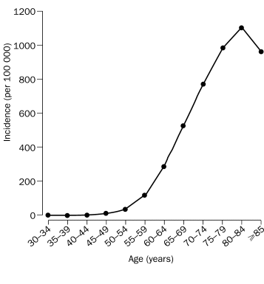
I turned 74 December 2021.
I am grateful prostate cancer did not arrive in my life 25 years ago. Now I think about it.
I am grateful that I had a score in my blood and urine tests, that alerted me now, instead of later, what I have not been thinking.
It goes without saying, my doctorate is in storytelling, not medicine, so get a second opinion
Incidence of prostate cancer and age

Slide 8
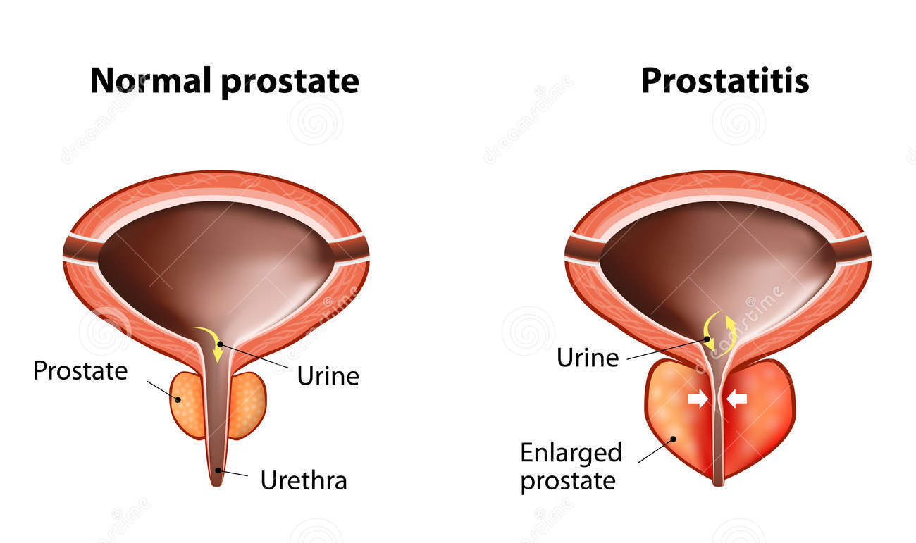
Some True Storytelling
Mine apparently looks like one on the right
I know it’s what’s true because I go to pee every hour or sooner,

Slide 9
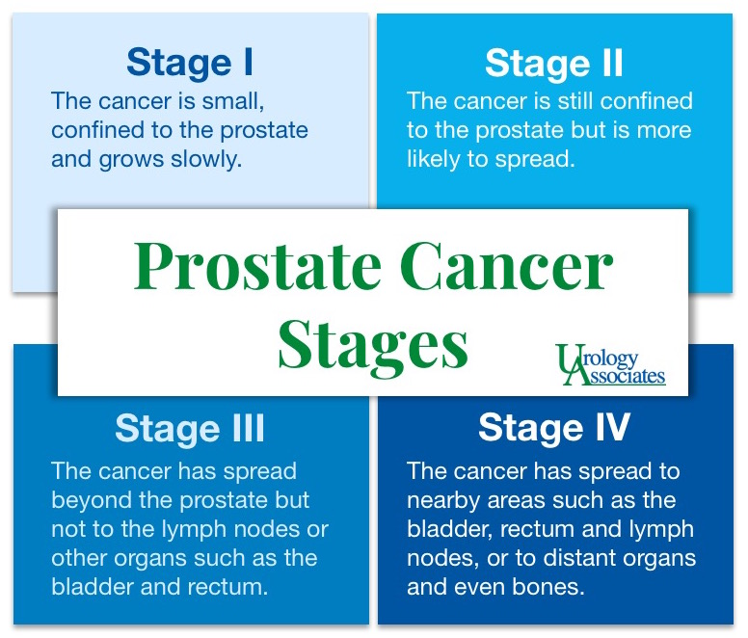
On Wednesday, Feb 2nd, 2022, the specialist doctor will give results of local scan (iodine injection) and the gamma scan (radiation) that can set off border patrol alarms for next 4 days.

Slide 10
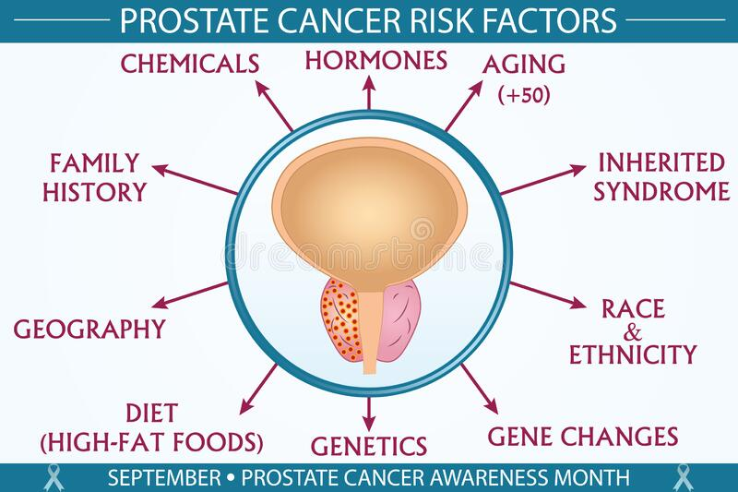
There are many causes

Slide 11
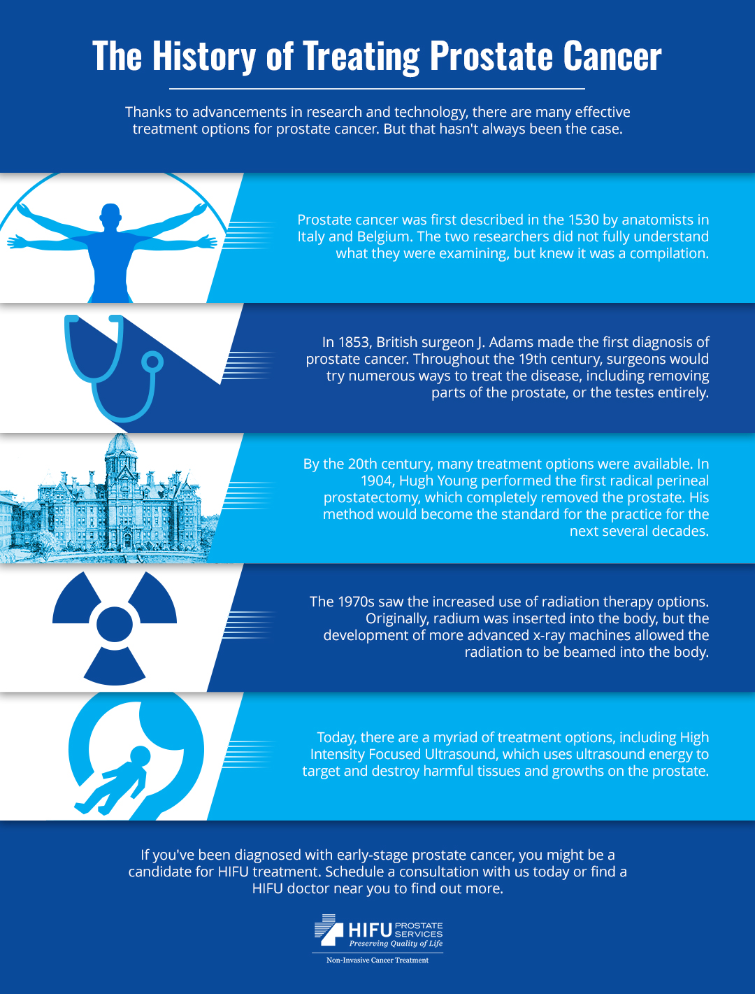
I have been informed from biopsy results, I have prostate cancer. Don’t know yet Jan 31, 2022 if its stage 1, 2, 3, or 4

Slide 12

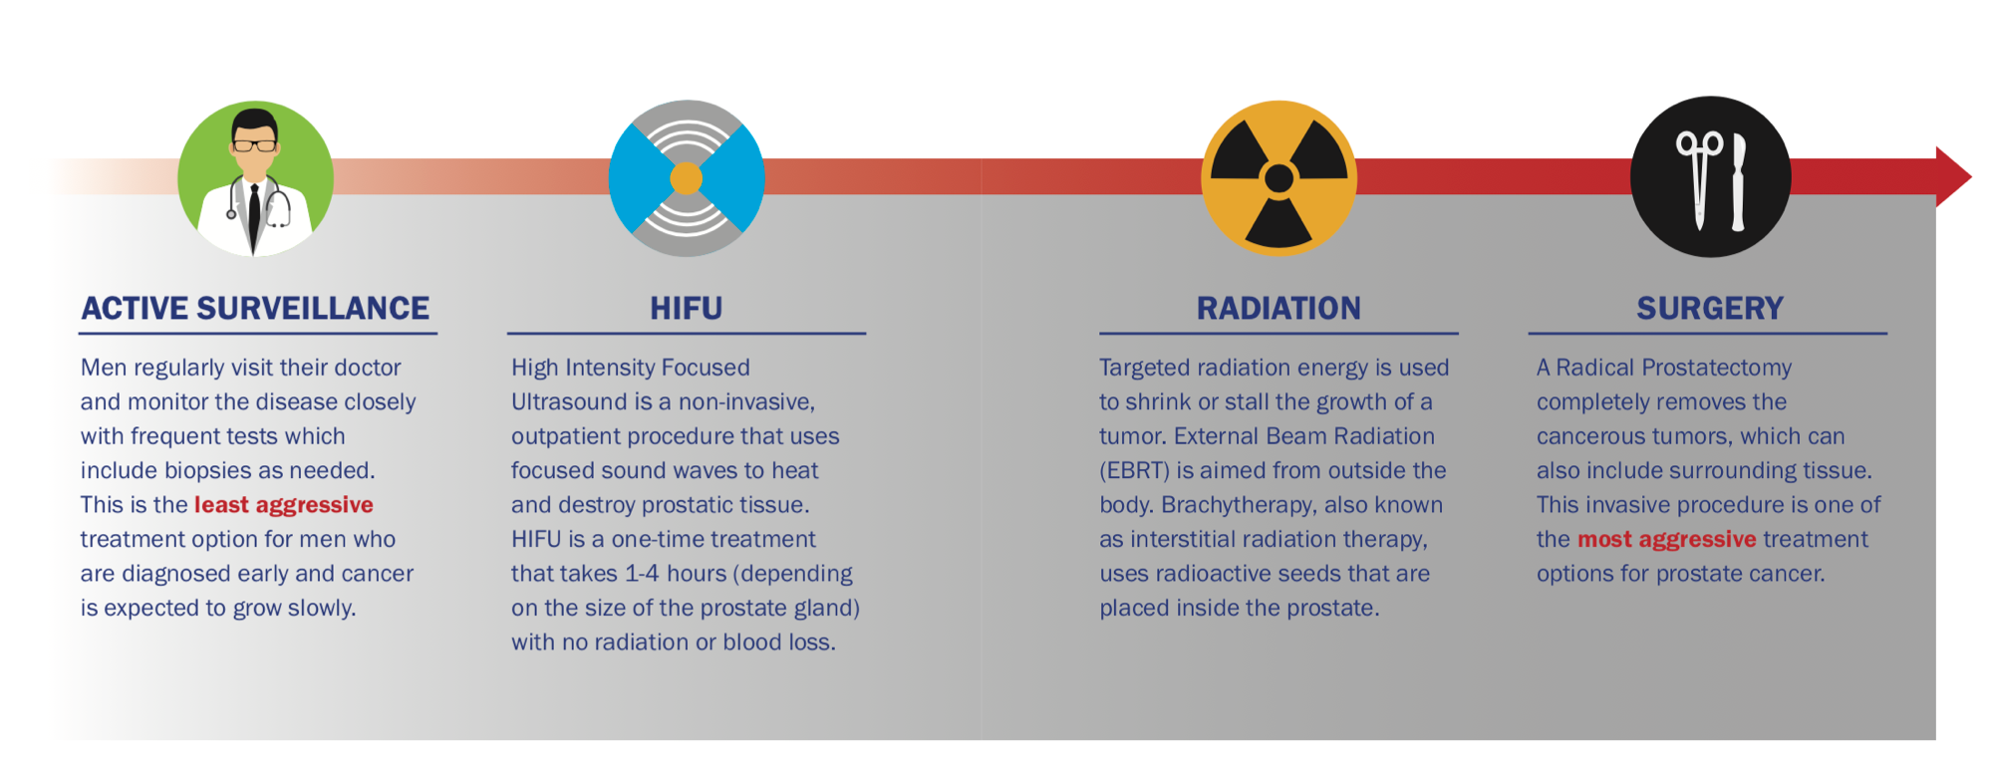
Four kinds of prostate treatment

Slide 13
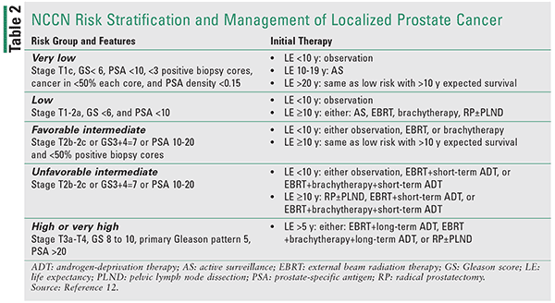

An example of the kinds of test results and their use in treatment shaping

Slide 14
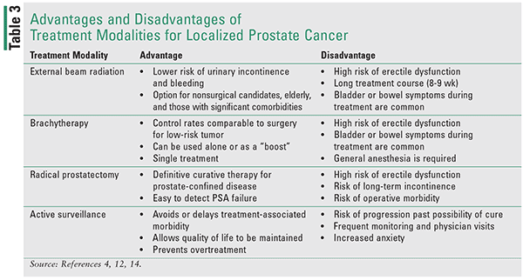

Slide 15
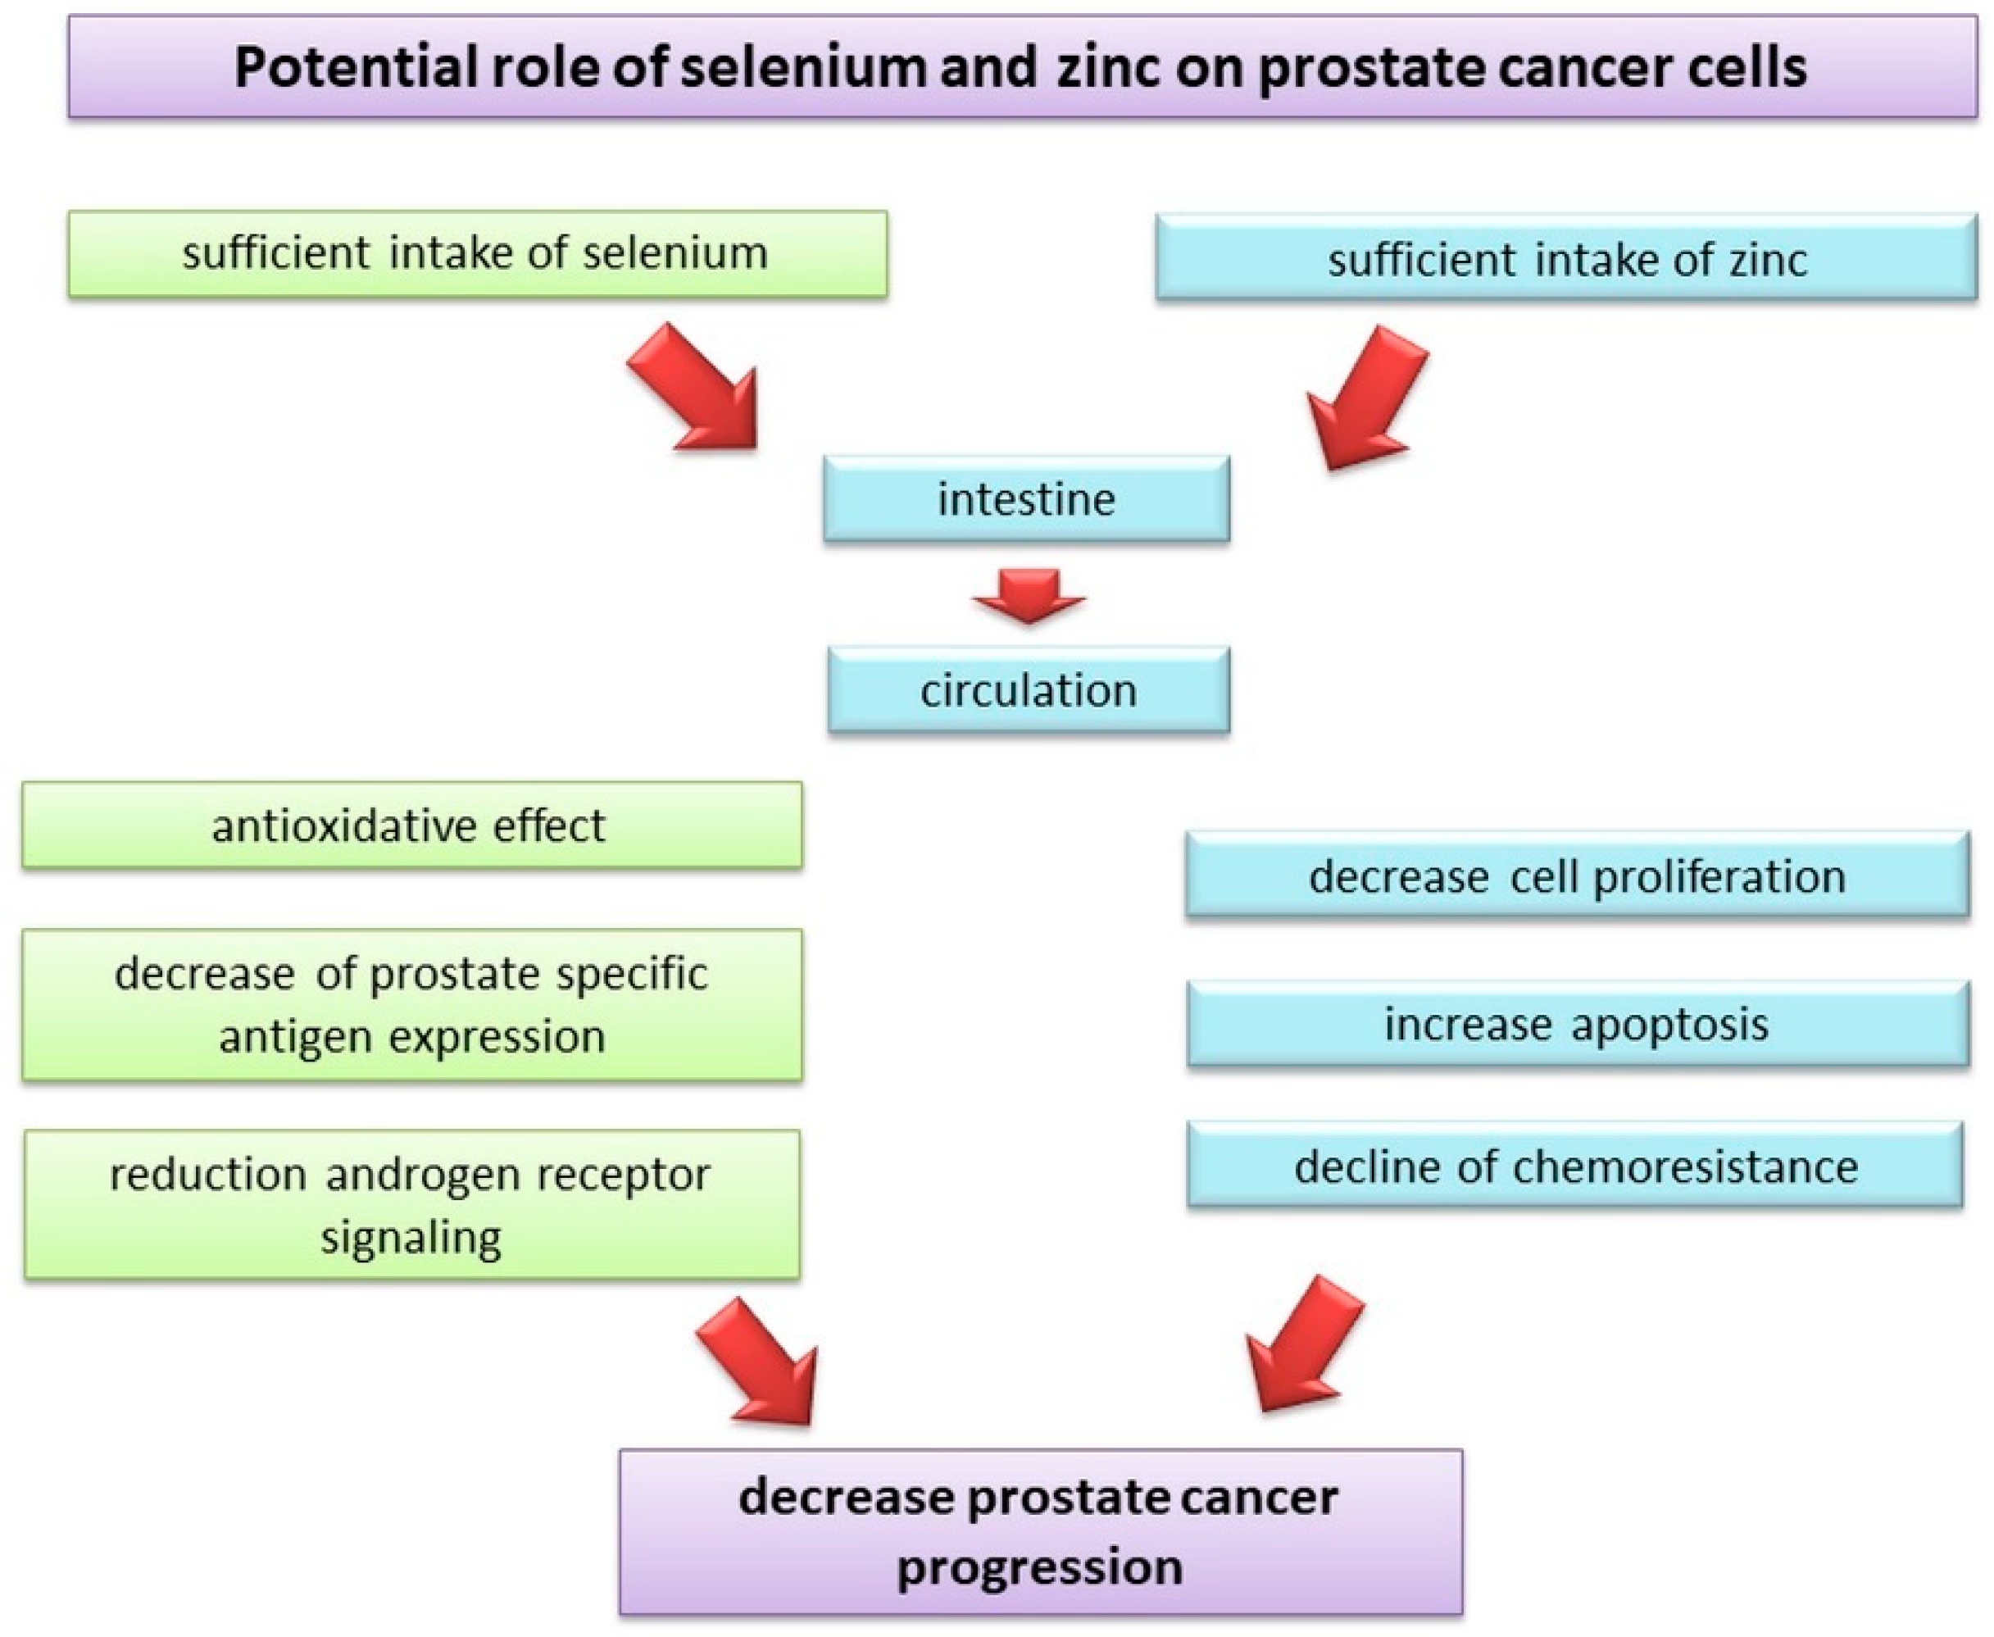
Check with your doctors, but appreciate the selenium and zinc can do in your diet supplements, etc.

Slide 16
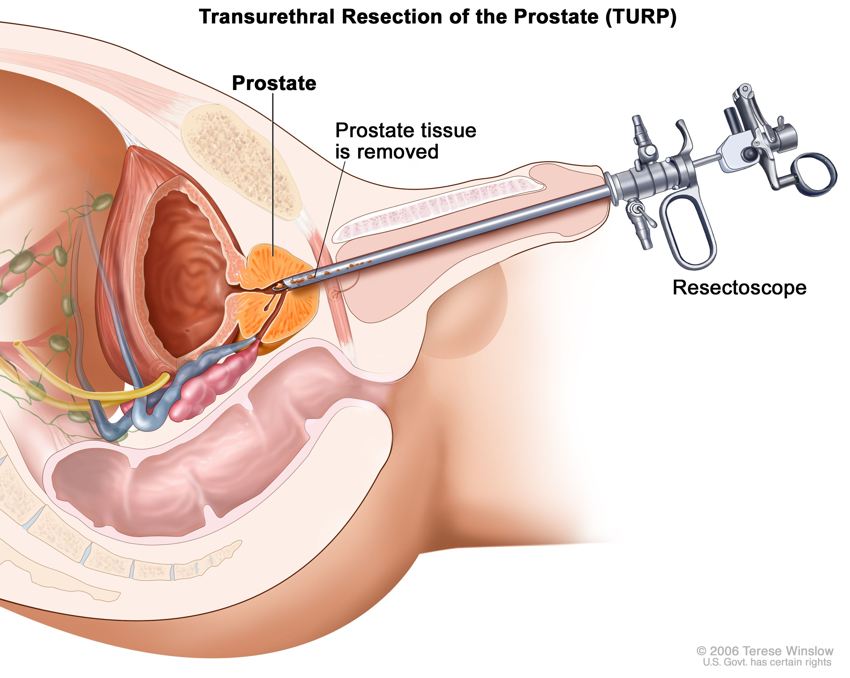
A scary example of medical technology and invasion of the body

Slide 17
How is prostate cancer distributed in geographic space?

Slide 18
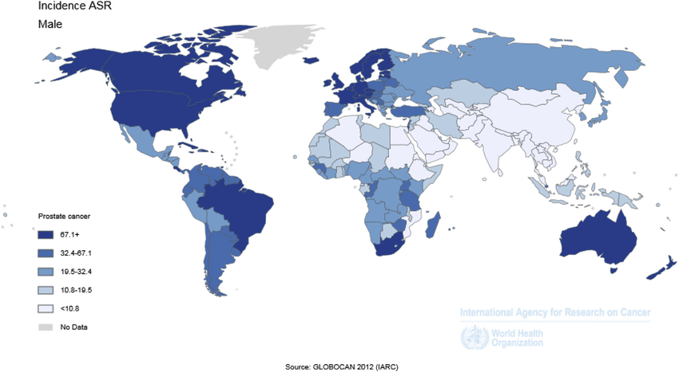
Prostate Cancer incidence rate varies by geography place

Slide 19
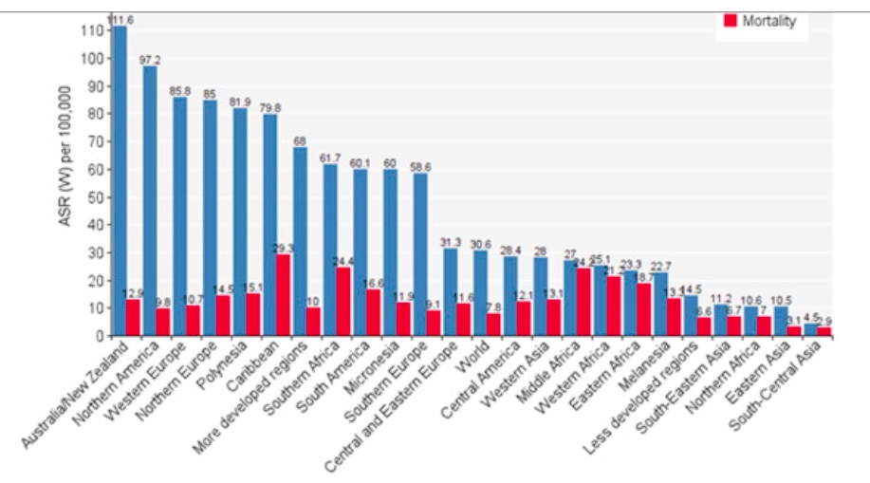
Blue is incidence rate
Look at the differences in geographic location for incidence of prostate cancer

Slide 20
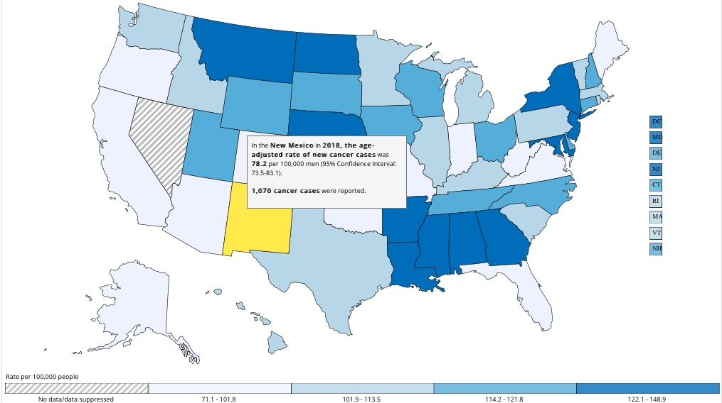
Where you live in the United States is correlated with the incidence of cancer. I live in New Mexico, so go figure. Our incidence is low…

Slide 21
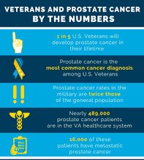
I am a Vietnam veteran, 1969-1970, and when you look at the statistics on prostate cancer, there is an efect

Slide 22
How is Prostate Cancer about Diet
You are what you eat
The Prostate tries to keep up
Changing what you eat and having a prostate impact takes time
Diet varys by geography as we saw in the slides

Slide 23
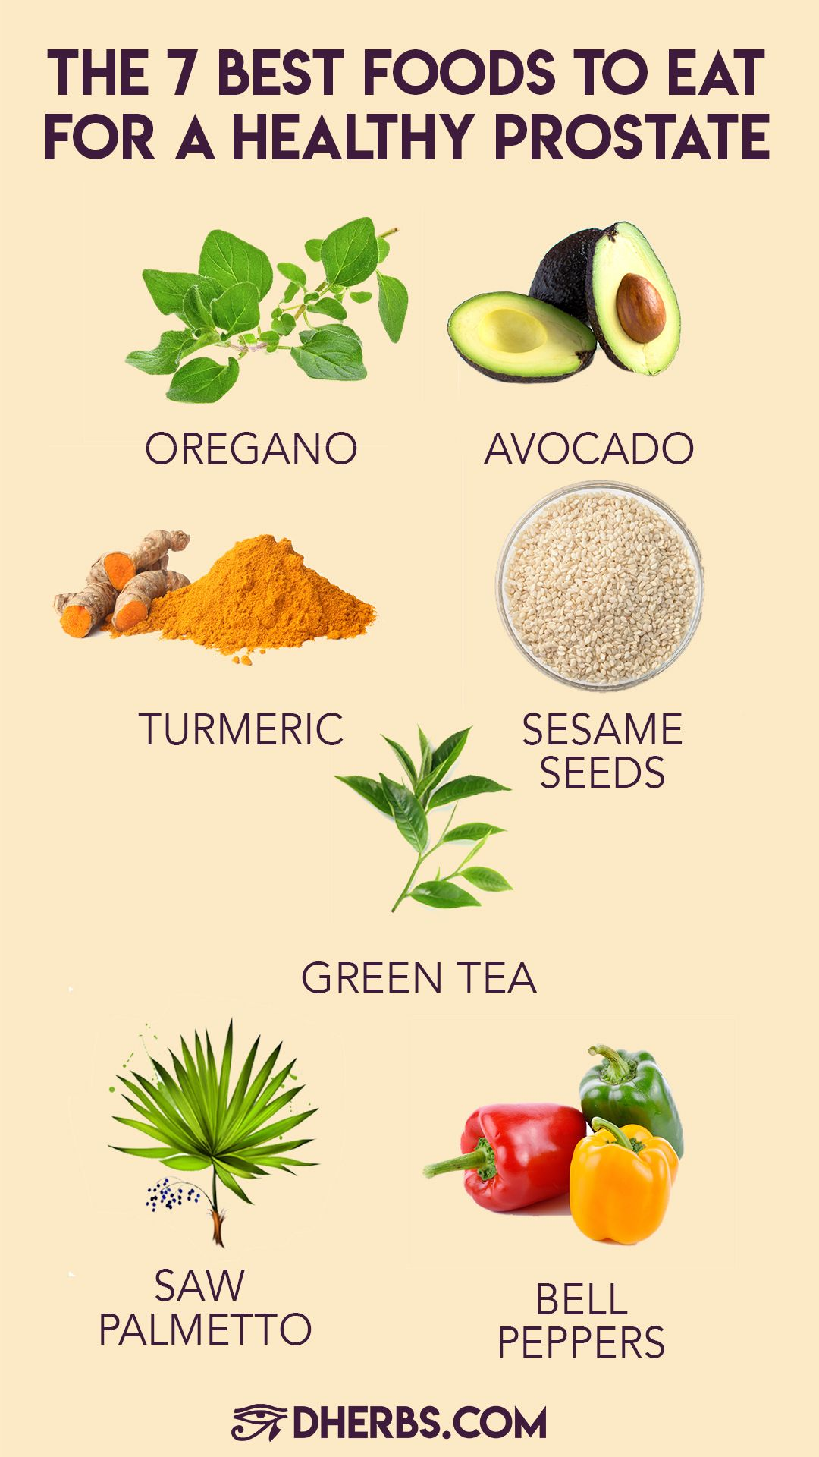
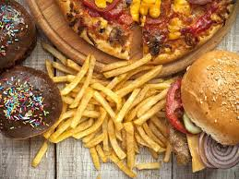
Before I met Grace Ann Rosile, some 24 years ago, I was eating the Worst Prostate Foods
On the Right, I am a vegan, and try to stay away from processed foods, and have a diet of uncooked foods, and the kinds of foods→

Slide 24
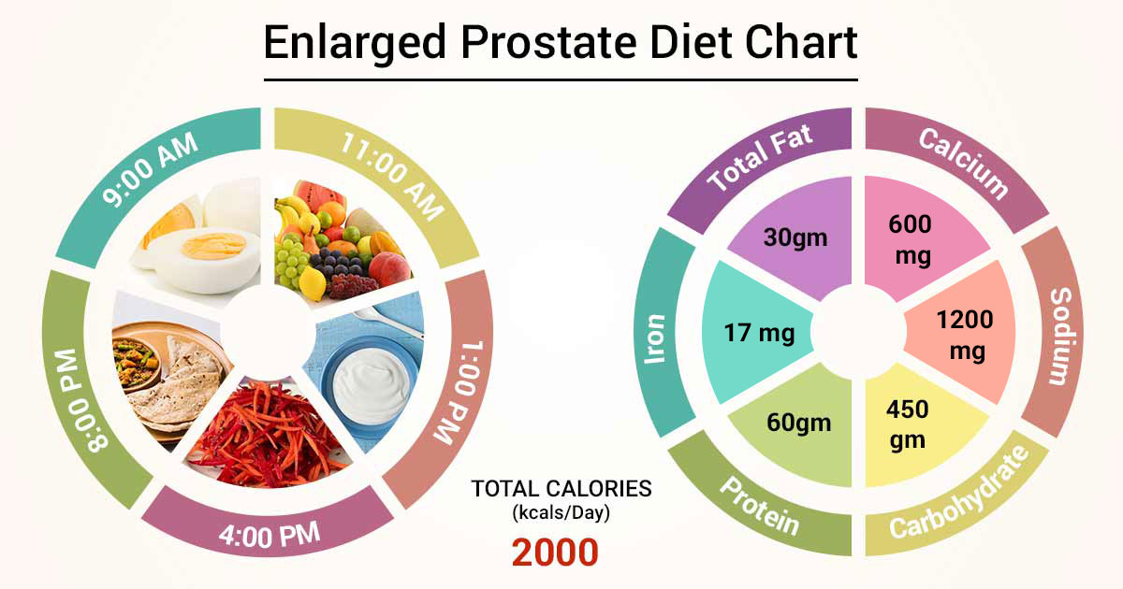
There is something about a diet of fruits and vegetable, not taking as long to digest, and not staying in the digestive tract. I am trying to eat less, and give the organs a chance to have a break

Slide 25
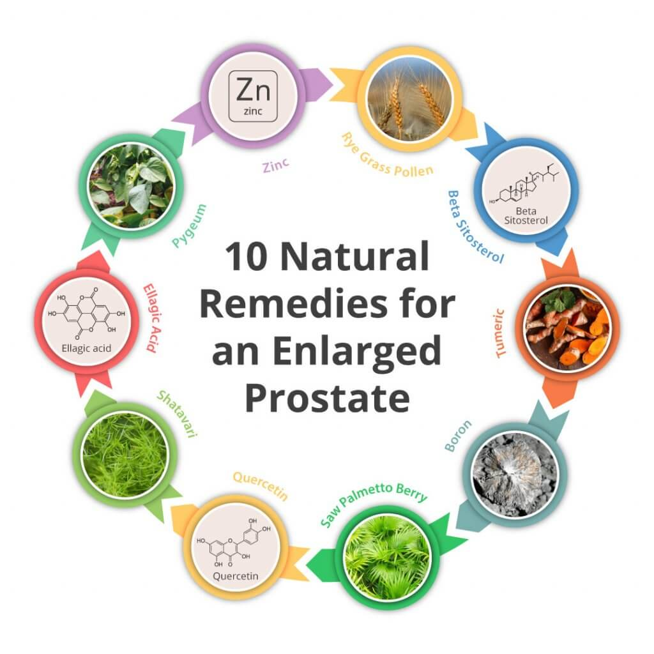
Check with your doctors
I do lots of natural remedies, and I listen to my doctors, and my wife.

Slide 26
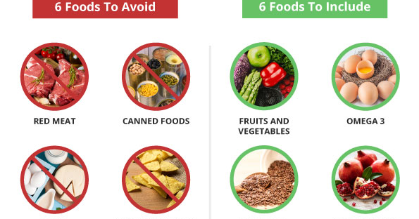

Slide 27
Can Prostate Cancer be affected by Movement of the Body
Body is an energy field
I started doing the videos that follow, and they actually helped.
Talk to you doctor before you go into exercise

Slide 28
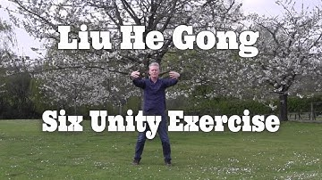
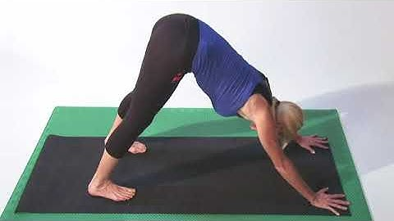

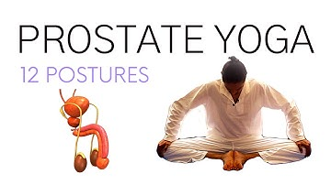
I did this one and was able to sleep 5 hours instead of 1;
Click here for YouTube
Click here for YouTube on Qigong; I did this one and remembered I sued to do this, It helped me
Click here for YouTube
Click here for YouTube

Slide 29
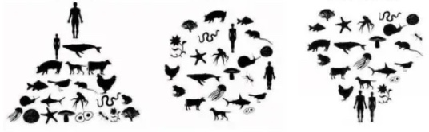
See https://enthinkment.com for more on ways you can change your consciousness about prostate cancer.
We are always thinking about something. Ego makes everything about us. Eco-consciousness, humans are one of many species on the planet.
Heart of care-consciousness is about being stewards of all life on this planet
EGO-Consciousness
ECO-Consciousness
Heart of Care-Consciousness

