Slide 1


Diagnosis of Prostate Cancer: Malignant & Aggressive
David Michael Boje
Feb 2 2022

Slide 3
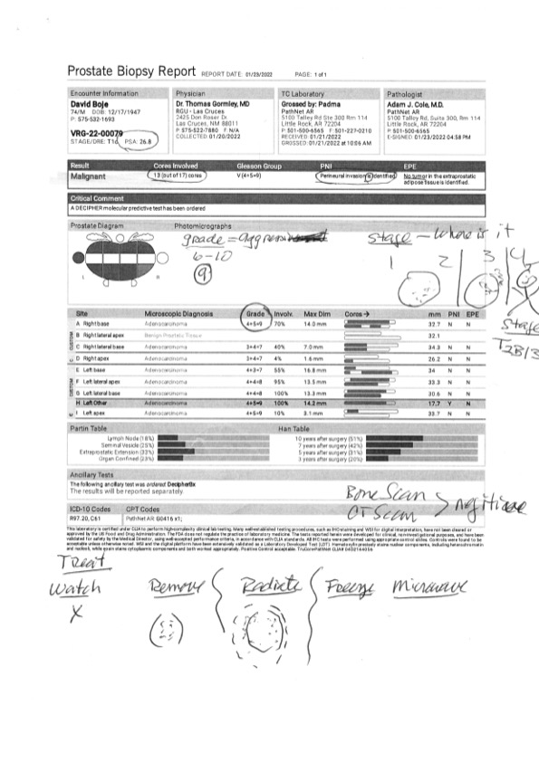
Stage 2B: Aggressive on way to Stage 3
It is all through the Prostate, and into the outer regions
PSA 26.8
Good news: Bone Scan Negative on metastatic disease

Slide 4
The biopsy showed grades involving
10 to 100% of 13 of 17 samples

Slide 5
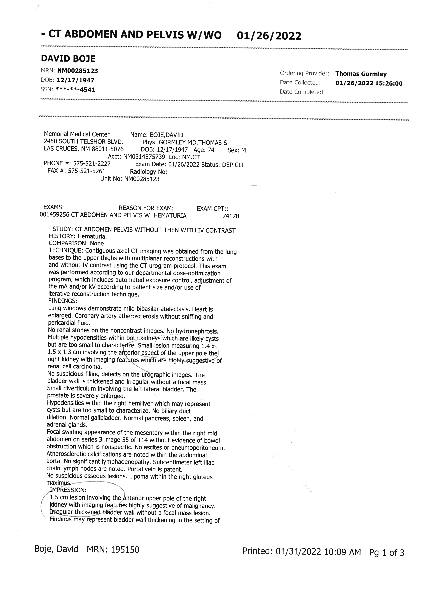
Watch the Kidney

Slide 6
About the Kidney

Slide 7
Enthinkment-ENACTMENT-QUANTUM STORYTELLING
My embodied spirituality does not dualize mind and body.
(E1) Enthinkment is dyadic, contrasting qualities against one another by association for learning
(E2) Enactment is monadic sense-datum parsed from experience of flow, assimilated to past event of experience.
(QS) Quantum Storytelling is triadic relation of Synechism (involving continuity of time)
Prostate and Kidney cancers are spatial embodiment; my embodied spirituality embodied in colonizer cells; I am naming the ‘Little Buddhas’.

