Slide 1

David M. Boje
Bakhtin meets Enthinkment Circle - YouTube (filmed before seminar - May 15, posted May 17 2022) enthinkment.com
Malmö University
What is the Riddle of Participative Thinking in Bakhtin’s Architectonic Dialogism?

Slide 2
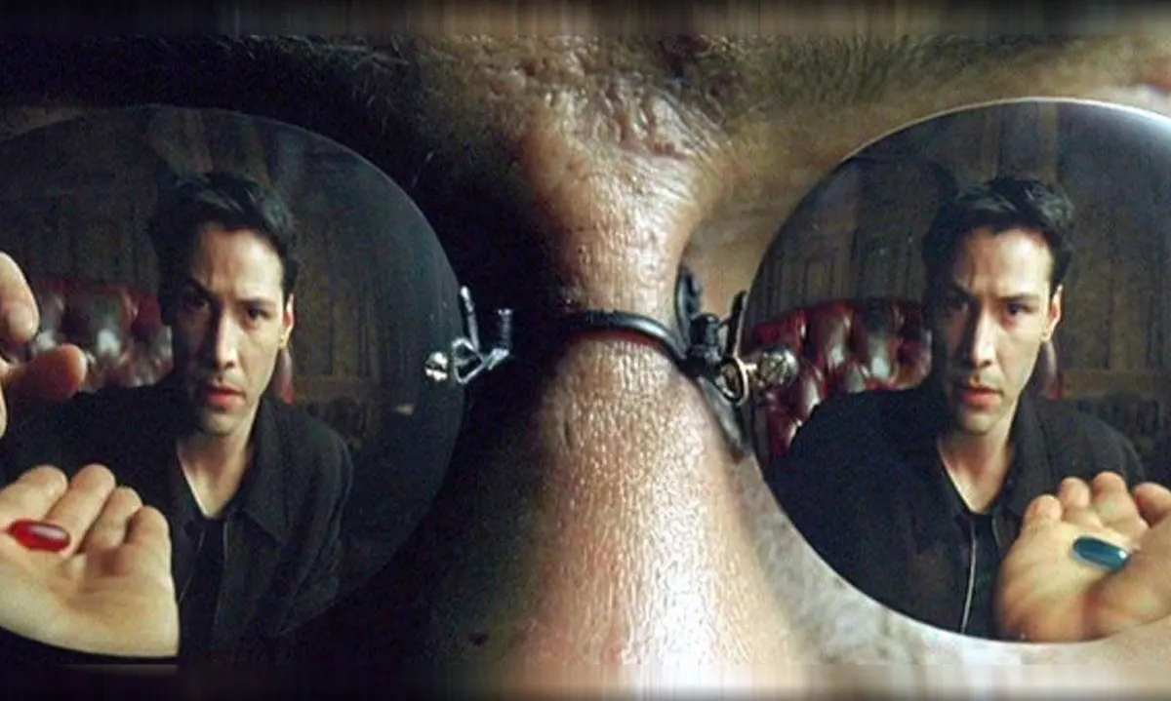
Part I
Working with Kenneth Mølbjerg Jørgensen
Boje, David M.; Jorgensen, Kenneth Mølbjerg. (2020). A ‘storytelling science’ approach making the eco-business modeling turn. Journal of Business Modeling, Vol. 8, No. 4, pp. 8-25. Click here for pre-press pdf. Please Click here for final print version PDF
Jørgensen, Kenneth Mølbjerg; Boje, David M. Storytelling Sustainability in Problem-Based Learning. Chapter to appear. Click here for pre-press pdf.
Jørgensen, K. M., & Boje, D. M. (2010). Resituating narrative and story in business ethics. Business Ethics: A European Review, 19(3), 253–264. https://doi.org/10.1111/j.1467-8608.2010.01593.x

Slide 3

Can we learn 2 Russian Words?
ISTINA → content-truth of each world, & we each participate in so many worlds
(antenarrative process #1 cracked heart of the Beneath of duality)
PRAVDA → synthetic-truth of right, just, or true-to both fact & sense in their concrete unity
(antenarrative process #4 the uncovering of what’s once-occurrent, Nautilus)
See pp. 36-37 (& footnotes) Bakhtin Toward a Philosophy of the Act
Bakhtin meets Enthinkment Circle - YouTube (filmed before seminar - May 15, posted May 17 2022
Notes:
Boje, David M. (2001) Chapter 7: Spectacle and Inter-Spectacle in The Matrix and Organization Theory. In Parker, Martin, Geoff Lightfoot, Matthew Higgins and Warren Smith (eds.) Science Fiction and Organization, London: Routledge. pp. 101-122.

Slide 4
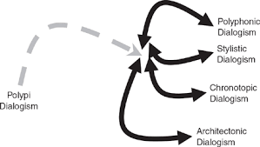
We address this riddle in questions of together-thinking in developing Gaia Ethics
How to create sustainable development and terrestrial ethics across borders via Architectonic dialogism

Slide 5
Let’s Start Simple: 7 W’s of Storytelling
WHAT –’ BLUE PILL=ISTINA theoretical-assumptions REFLECTING facts, opinions, silos called ‘epistemology are emotive-volitional tones, so settled forming GAP with BEING
WHEN –BLUE PILL=ISTINA REFLECTING settled assumptions of past events of history (retrospection) at GAP with BEING
WISH - BLUE PILL=ISTINA REFLECTING settled assumptions of varied Bets invested in Future projects (plots) after ante-up, at GAP with BEING
WHY – RED PILL= PRAVDA RADICAL REFLEXIVITY UNSETTLING & uncovering what covered in this Once-Occurrent Eventness of BEING, inquires called ‘ontology’, at GAP with participants, the inquirer is also a participant
WANTS – Emergences of Emotive-Volitional Tones: retrospection-to-past &/or arriving-from-future (prospection) sensemaking at GAP with BEING
WHO – 4 Who’s asking for or driving each story or narrative with emotive-volitional tone forces
WHERE – BLUE PILL=ISTINA REFLECTING wild hunches, abductions, 6th senses, the eternal timeless where of the cosmos, settled at GAP with BEING

Slide 6

Welcome to ARCHITECTONIC DIALOGISM
WHAT –’ BLUE PILL=ISTINA theoretical-assumptions REFLECTING facts, opinions, silos called ‘epistemology are emotive-volitional tones, so settled forming GAP with BEING
WHEN –BLUE PILL=ISTINA REFLECTING settled assumptions of past events of history (retrospection) at GAP with BEING
WISH - BLUE PILL=ISTINA REFLECTING settled assumptions of varied Bets invested in Future projects (plots) after ante-up, at GAP with BEING
WHY – RED PILL= PRAVDA RADICAL REFLEXIVITY UNSETTLING & uncovering what covered in this Once-Occurrent Eventness of BEING, inquires called ‘ontology’, at GAP with participants, the inquirer is also a participant
WANTS – Emergences of Emotive-Volitional Tones: retrospection-to-past &/or arriving-from-future (prospection) sensemaking at GAP with BEING
WHO – 4 Who’s asking for or driving each story or narrative with emotive-volitional tone forces
WHERE – BLUE PILL=ISTINA REFLECTING wild hunches, abductions, 6th senses, the eternal timeless where of the cosmos, settled at GAP with BEING

Slide 7
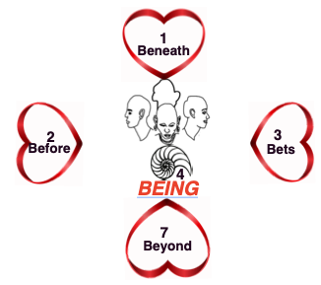
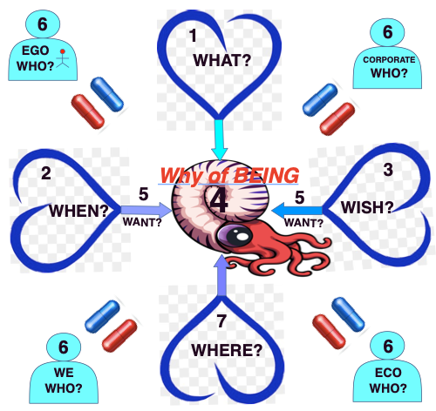
Radical Reflexivity = ANTERIOR (aka Antenarrative-BEING) process of UNSETTLING
4 ♥-processes of Reflection already settled, Taken-to-♥
Once Upon A Time, I hung out with Harold Garfinkel at UCLA 1979-1986
Mehan, H., & Wood, H. (1976). De-secting ethnomethodology. The American Sociologist, 13-21. (Click Here related article)
McHugh, P., Raffel, S., Foss, D. C., & Blum, A. F. (1974). On the beginning of social inquiry Routledge & Kegan Paul.
Pollner, M. (1991). Left of ethnomethodology: The rise and decline of radical reflexivity. American Sociological Review, 370-380.
Gephart chapter in Boje, D., Gephart, R. P., & Thatchenkery, T. J. (Eds.). (1995). Postmodern Management and Organization Theory. SAGE Publications.
Cunliffe, A. L., Luhman, J. T., & Boje, D. M. (2000). Re-storying narrative temporality: Implications for the organizational researcher.
Cunliffe, A. L., Luhman, J. T., & Boje, D. M. (2004). Narrative temporality: Implications for organizational research. Organization Studies, 25(2), 261-286. (Click Here)
Cunliffe, A. L., Luhman, J. T., & Boje, D. M. (2016) Panel presentation at the All Academy Symposium, Narrative Research in Time, presented at the Academy of Management Conference, Toronto, Canada. Retrieved on August (Vol. 30, p. 2016). (Click Here)
Talaoui, Yassine. (2022) Business Intelligence (BI) as Simulacra—A radical reflexive look at the BI & analytics of sustenance of strategy work. Dissertation, University of Vaasa, Finland.

Slide 8
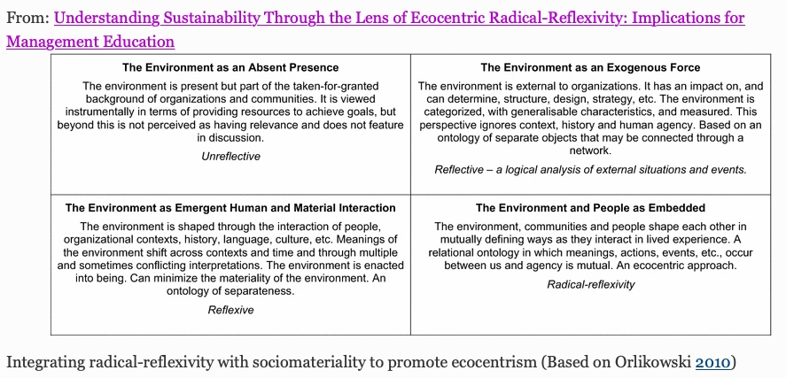
Rethinking Radical Reflexivity
Figure from Allen, S., Cunliffe, A. L., & Easterby-Smith, M. (2019). Understanding sustainability through the lens of ecocentric radical-reflexivity: Implications for management education. Journal of Business Ethics, 154(3), 781-795. (Click Here)

Slide 9
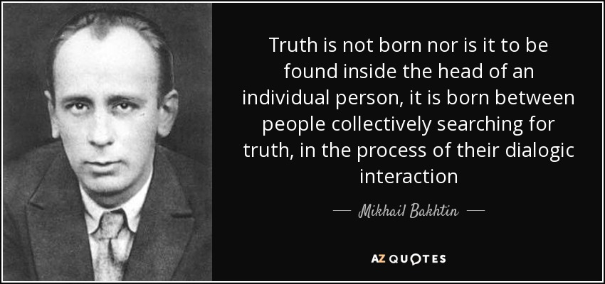
Mikhail Bakhtin
The ‘centrality of concrete architectonics’ attempts to solve the riddle of dual-face of answerability

Slide 10
Mikhail Mikhailovich Bakhtin
Born: Nov 16, 1895
Birthplace: Oryol, Russia
Died: Mar 7, 1975
Death place: Moscow, Russia
Education: Saint Petersburg State University, Odessa University
Written works: Toward a Philosophy of the Act, Rabelais and His World (dissertation), Problems of Dostoevsky’s Poetics, Speech Genres and Other Late Essays; The Dialogic Imagination (anthology); Art & Answerability (anthology)

Slide 11
Works and ideas
Early Notebooks 1919-1923 – became Toward a Philosophy of the Act (19993)
1929 Dialogic Participation (Problems of Dostoevsky’s Poetics (Polyphonic Dialogism)
1940 Dissertation→ Rabelais and his World (Carnivalesque)
Dialogic Imagination Anthology
  Heteroglossia
  Chronotope
  Stylistics
  Speech Genres and Other Late Essays
Mikhail Mikhailovich Bakhtin
Notes:
Bakhtin was a Russian philosopher, literary critic and scholar who worked on literary theory, ethics, and the philosophy of language. Although Bakhtin was active in the debates on aesthetics and literature that took place in the Soviet Union in the 1920s, his distinctive position did not become well known until he was rediscovered by Russian scholars in 1960s and became translated into English in 1980s and 1990’s

Slide 12

Our Together-Listening & Together-Telling Training Practices
We do this by conducting storytelling-listening and storytelling participative sessions among members of organizations to activate deed-performing thinking rather than just retelling history or having theoretical discussions of possible futures
Together

Slide 13
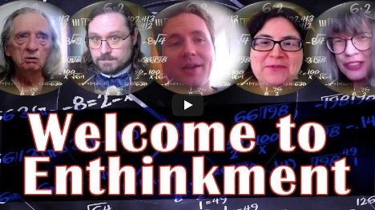
Mikhail Mikhailovich Bakhtin
And the ENTHINKMENT CIRCLE
Enthinkment.com

Slide 14
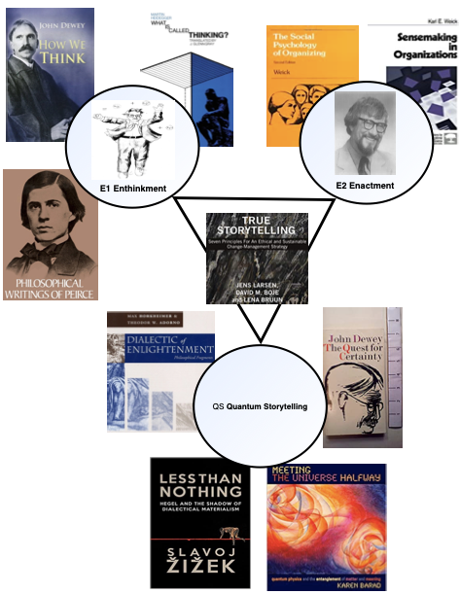
Where does Bakhtin Fit in this?
Boje's new book On Louis Ralph Pondy's Two Gifts to Management Thought (download free until published by Routledge)

Slide 15
Legacy Relevant to Enthinkment Circle
Mikhail Mikhailovich Bakhtin
Early life – formed Bakhtin Circle Formed Bakhtin Circle with:
    Lev Vasilievich Pumpianskii (1891-1940),
    Ivan Ivanovich Sollertinskii (1902-1944)
And its dialogic and religious content offended Joseph Stalin
Career – with exile to Siberia, it was interrupted
Works and ideas – some come from
Disputed texts
Legacy
Co-founder of Bakhtin Circle during times of Revolution

Slide 16
Legacy Relevant to Enthinkment Circle
The art of thinking, embodying values is a “deed-performing thinking” (Toward Philosophy of the Act, TPA); My thinking” from my unique place in Being” (57)
I myself “the one thinking actuals”, “the actually performed act of thinking” (TPA, 58)
Does not sever act of thinking from its ontological roots (TPA, 54)
Seeks unvarnished truth, Beneath the veil of false claims
Distinguishes ISTINA (theoretical/abstract thinking of bystander) from PRAVDA (acts of thinking in once-occurrent event-ness of Being, with answerable consequences)
Asks the question: “Who is the author?” (Art & Answerability A&A 210)
‘Historical thinking’ that not stuck in Bergson’s durée retrospection
‘Vision thinking’ about the future “yet-to-be-achieved unity” (A&A 210)
”Participative thinking” (TPA 59), “participative thinking in lived life” (60), that is “Answerable thinking” (58)

Slide 17
What is Dual-Faced Answerability?
Special Answerability –the bystander who looks on at the suffering, doing nothing
Moral Answerability – the compellent act or deed, intervening in once-occurrent even of Being

Slide 18
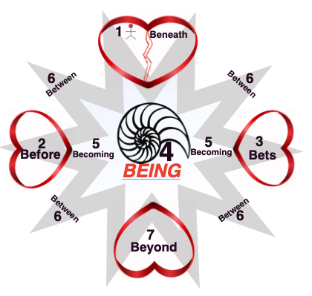
What Are Seven Antenarrative Processes?
Truestorytelling.org
Heidegger Model
Antenarrative.com
Enthinkment.com
Bakhtin Model

Slide 19
Antenarrative Processes VIA Heidegger
Antenarratives VIA Bakhtin
1. BENEATH-Heart, beneath to the thematizing of fore-conception, the fore-categorizing of opinions, and calculative thinking to another kind of thinking
2. BEFORE-Heart, before of layer upon layer of history, accessed by doing retrospective sensemaking stories already there, including fore-having the ‘little wow moments’, history of some decades, centuries, or millennia of ways of thinking
3. BETS-Heart, bets on the Future, by doing prospective sensemaking, using foresight (or foretelling) to engage in opportune moments for strategic thinking.
4. BEING (depicted by Spiral Nautilus), to encounter Being-in-the-world, unconcealing the fore-gotten, the what lies hidden, disclosing Being in-spacetimemattering, unfolding present processes
5. BECOMING in two Directions: what is emerging in the fore-caring from Before, and Bets on the future (ante-up as they say in poker, putting down your bets) and being answerable for the outcomes and consequences
6. BETEWEEN four Who-consciousnesses: what we are taking-to-heart in fore-structuring? 'Who' is asking for it, who are we narrating or storying to or for? We propose four who’s of together-listening and together-telling: ego-centric, we-centric, corporate-centric, and ecologically-centric
7. BEYOND-Heart, to what is intuitive in our-fore-grasping something not of the five senses, hunches, 6th sense, or what Peirce called ‘abduction’ (intelligent guesses that need to be confirmed by inductive inquiry)
WHAT –’ BLUE PILL=ISTINA theoretical-assumptions REFLECTING facts, opinions, silos called ‘epistemology are emotive-volitional tones, so settled forming GAP with BEING
WHEN –BLUE PILL=ISTINA REFLECTING settled assumptions of past events of history (retrospection) at GAP with BEING
WISH - BLUE PILL=ISTINA REFLECTING settled assumptions of varied Bets invested in Future projects (plots) after ante-up, at GAP with BEING
WHY – RED PILL= PRAVDA RADICAL REFLEXIVITY UNSETTLING & uncovering what covered in this Once-Occurrent Eventness of BEING, inquires called ‘ontology’, at GAP with participants, the inquirer is also a participant
WANTS – Emergences of Emotive-Volitional Tones: retrospection-to-past &/or arriving-from-future (prospection) sensemaking at GAP with BEING
WHO – 4 Who’s asking for or driving each story or narrative with emotive-volitional tone forces
WHERE – BLUE PILL=ISTINA REFLECTING wild hunches, abductions, 6th sense, the eternal timeless where of the cosmos, settled at GAP with BEING

Slide 20
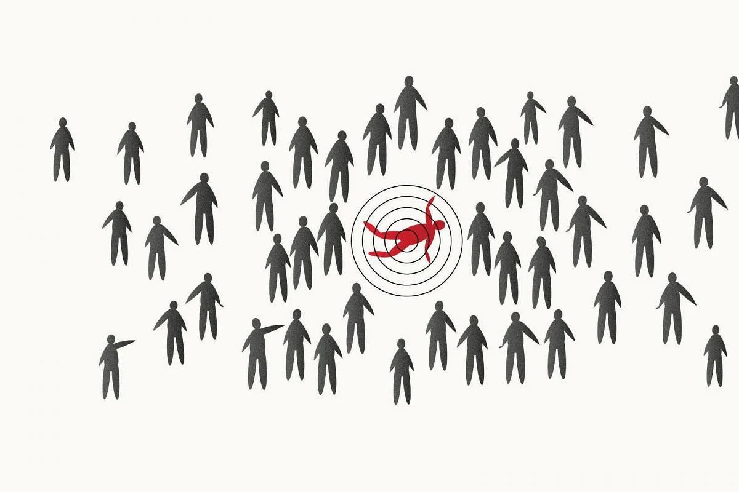
Time and space is a persistent narrative riddle
How do narratives and counternarrative trick us into plotting time & space that is theoretical, mathematical, or quantitative?

Slide 21
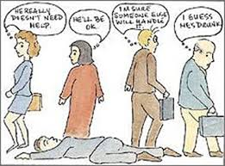
This riddle of the dual-faces of ethical- and of bystander-answerability
What would you do?

Slide 22

What is Participative Thinking?
It does not mean I live and act for my own sake.
It is the centrality of our unique participation-in-Being within the architectonic of the ‘actually’ lived-experiences has an ethical answerability
It is not merely a bystander answerability that does not intervene in once-occurrent on-going event

Slide 23
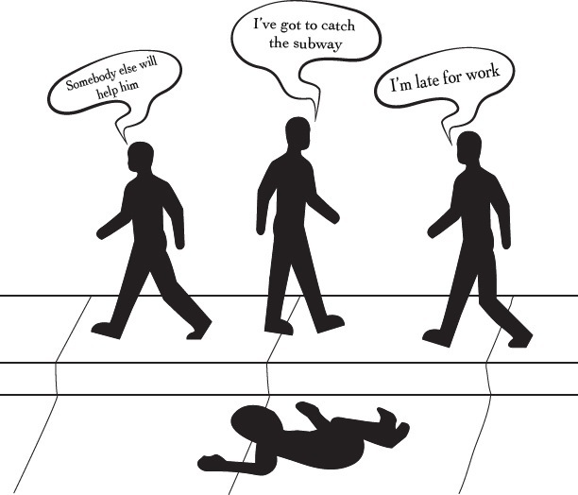
What is time?
What is space?
What is their relationship?
This riddle of the dual-faces of ethical- and of bystander-answerability pits the actual usage of time and space against the more theoretical, qualitative, mathematical or geometrical conceptions of time and space.

Slide 24
Part II
Working with Ann Starbæk Bager
Bager, A. S. (2013). Dialogue on dialogues: Multi-voiced dialogues (dialogism) as means for the co-production of knowledge in and on leadership communicative practices. Academic Quarter| Akademisk kvarter, 146-159.
Bager, A. S. (2015). Organizational ethnography: an interaction analysis of identity work through the study of other-orientation and storytelling practices in a leadership development forum. Tamara Journal for Critical Organization Inquiry, 13(3).
Bager, A. S. (2019). A multimodal discourse analysis of positioning and identity work in a leadership development practice.: A combined dialogicality and small story analysis. Communication & Language at Work, 6(1), 40-62.
Bager, A. S., Svane, M., & Jørgensen, K. M. (2018). Ethics perspective on entrepreneurship. In The Palgrave handbook of multidisciplinary perspectives on entrepreneurship (pp. 457-477). Palgrave Macmillan, Cham. (download @ Research Gate)
Bager, A. S., Jørgensen, K. M., & Raudaskoski, P. (2016). Dialogue and Governmentality-in-Action. Studies of Discourse and Governmentality: New perspectives and methods, 66, 209-234.
Bager, A. S., & Mølholm, M. (2020). A methodological framework for organizational discourse activism: An ethics of dispositif and dialogue. Philosophy of Management, 19(1), 99-126.
Boje, D., Saylors, R., & Bager, A. S. (2020). Conference track: Organizational Storytelling Activism: Using praxes of inclusive storytelling to enable diversity and equity.
Jørgensen, K. M., Boje, D. M., Svane, M. S., Bager, A. S., & Larsen, J. (2020). The story maker: Reflexive activism for sustainability in the business school. In Leadership and Change in Business Schools–What Next?. Routledge. (Click Here)
Click for Boje’s ENTHINKMENT CIRCLE Video overview of today’s session on Bakhtin and his living story life as a writer under Stalinism

Slide 25
Coalition of Immokalee Workers (CIW)
Youtube VIDEO https://www.youtube.com/watch?v=-0RLlvmh3Y4
On May 12, 2022, farmworkers, investor allies, and conscious consumers held a rally and street theater in front of Trian Partners, offices of Wendy's Board Chairman Nelson Peltz
Why we Boycott Wendy’s

Slide 26
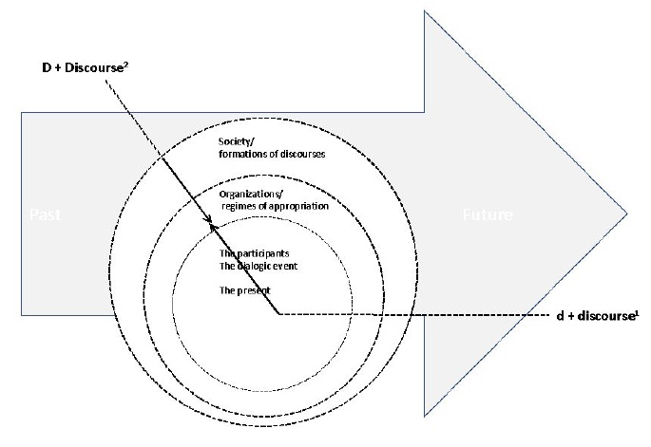
Bager 2019: 43

Slide 27
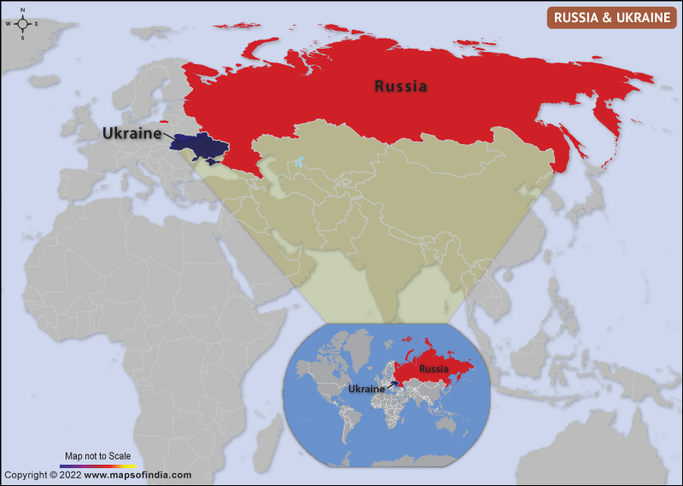
How was Bakhtin’s writing affected by times, places, & conditions
The architectonics of emotional-volitional compellentness is not a Kantian abstract theoretical standpoint
Bakhtin (1895-1975) writing-time spans Bolshevik Revolution & two world wars in spaces (places)

Slide 28
Mikhail Bakhtin (1895-1975) Architectonic & Dissertation Context
Bakhtin, Mikhail M. (1981). The Dialogic Imagination: Four Essays. An anthology writing from 1919 to 1971, edited by Michael Holquist; Translated by Caryl Emerson & Michael Holquist. Austin, TX: University of Texas Press.
Bakhtin, Mikhail M. (1984a). Problems of Dostoevsky’s Poetics. 1929, Problemy tvorchestva Dostoevskogo, Leningrad; 1963, Problemy poetiki Doestoevskogo, Moscow; 1984, Problems of Dostoevsky’s Poetics, translated to English by Caryl Emerson, Introduction by Wayne C. Booth. London/Minneapolis: University of Minnesota Press.
Bakhtin, Mikhail M. (1984b). Speech Genres & Other Essays. 1979 Aesthetics of Verbal Creativity edited by Sergey Averinstev and Sergey Bocharov; 1984 Speech Genres & Other Essays, translated by Ven W. MCGee; Edited by Carly Emerson and Michael Holquist; Introduction by Michael Holquist. Austin, TX: University of Texas Press.
Bakhtin, Mikhail. M. (1984c). Rabelais and his World. Late 1930;s notebooks into single 1940 dissertation submitted as thesis to Gorky Institute of World Literature, delayed defense by WWII, defended 1947 awarded lesser degree. 1960 friends campaigned to get it published. 1965 Russian publication, Moscow, Translated from Russian to English by Helene Iswolsky (first appeared in English 1968); foreword Krystyna Pomorska; Prologue Michael Holquist. Bloomington, IN: Indiana University Press.
Bakhtin, Mikhail. M. (1990). Art and Answerability: Early Philosophical Essays. Essays first published in Russian ca. 1919 (pp. 1-3, Art & Answerability), ca. 1920-1923 (pp. 4-456, Author and Hero in Aesthetic Activity), and ca. 1924 (pp. pp. 257-326, The Problem of Content, Material, and Form in Verbal Art. 1990 translated to English by V. Liapunov; ed. M. Holquist and V. Liapunov). Austin, TX: University of Texas Press.
Bakhtin, Mikhail. M. (1993). Toward a Philosophy of the Act. First written in notebooks (1919-1921), first published 1985-1986 as part of the work FIlosofiia I sotsiologiia nauki I tekhnike: Exhegodnik. The 1990 translation by V. Liapunov; ed. M. Holquist and V. Liapunov). Austin, TX: University of Texas Press.
World War I
Jul 28, 1914 – Nov 11, 1918
World War II
Sep 1, 1939 – Sep 2, 1945
Bolshevik Revolution (1917-1923)
Nov 6-7, 2017: Vladimir Lenin launched a nearly bloodless coup d'état against Duma's provisional
government

Slide 29
Dates | Places | Bakhtin’s Situation
1895 | Oryol City (aka, Orel) in Russia | Bakhtin born 16 Nov in Oryol City, 229 mi. south/southwest of Moscow
1914-1917 | St. Petersburg (now Leningrad) | Attended and graduated from University of St. Petersburg At age 16, stricken with osteomyelitis (inflammation of bone tissue)
1917 | Oryol City | Russian Revolution broke out
1918 | Oryol City | Published 2-page article: ‘Art and Responsibility’ which with two other essays accepted 1920-1923 & 1924 but publication postponed would become part of 1990 Art and Answerability book in English. Formed Bakhtin Circle with: Lev Vasilievich Pumpianskii (1891-1940), Ivan Ivanovich Sollertinskii (1902-1944)
1920-1921 | Vitebsk City in Belarus | Bakhtin Circle expanded, extablish the ‘dialogic’ concept Matvei Isaevich Kagan (1889-1937), Pavel Nikolaevich Medvedev (1891-1938), Valentin Nikolaevich Voloshinov (1895-1936) 1921 Bakhtin Married his nurse, Elena Aleksandrovna Okoloveich, who was part of Bakhtin Circle and she scribed parts of 1919-1921 notebooks stored in a wood shed until 1960s, and became 1993 Toward a Philosophy of the Act book
1924-1928 | St. Petersburg (now Leningrad) | 1928 Medvedev’s book is couched in Marxist language so it can be published
1929 |  | Voloshinov’s book is couched in Marxist language so it can be published Bakhtin publishes Problems of Dostoevsky’s Poetics book Joseph Stalin becomes dictator Bakhtin arrested by Stalinists, charged with practicing religious beliefs, exiled, and sentenced without trial for 10 years northern Siberia ‘Kazakh Autonomous Soviet Socialist Republic’ along with several members of Bakhtinian Circle. Able to commute sentence to 6 years in Kazakhstan, for health reasons and favorable book review of Dostoevsky’s Poetics by party member
1930-1936 | Kustani City | 1930 he received permission to travel to the city of Kustani to find work himself, instead of being assigned a job by the government. Got position as an accountant in a local government office and helped train workers in the area in clerical skills. 1934 exile officially ended, but Bakhtin opted to remain in Kustani for another two years.
1936-1937 | Saransk City (Russia); town of Savelovo (outside Moscow) | Bakhtin returned to Russia in 1936, settled in Saransk and took a teaching job at Mordovian Pedagogical Institute. 1937, he moved to the town of Savelovo; being only a hundred kilometers outside Moscow (was able to once again appear in intellectual and academic gatherings) Bakhtin has worked on a book: The Novel of Education and Its Significance in the History of Realism, but tragically the publishing house was blown up in German invasion, the manuscript lost; thinking it being published, he had used pages of the original for cigarettes
1938 | Savelovo | Bakhtin’s right leg is amputated He kept working form 1937 & 1938 on the ‘chronotopes’ and ‘discourse and the novel’ essays that would become part of Dialogic Imagination book. Gave lecture in Moscow at Gorsky Institute
1940 |  | Finished dissertation on Francois Rabelais, but due to war it was not defended Bakhtin taught German in school
1945 |  | Rabelais and his World, book published
1951 |  | Defended dissertation on Rabelais
1952-1953 |  | Bakhtin is writing material for a book ‘the Genres of Speech’ which after his death would become part with other pieces in (1986) Speech Genres & Other Essays
1971 |  | 13 Dec, his wife, Elena Aleksandrovna Okolovich, died
1975 |  | The Dialogic Imagination, book published in Russian
1975 | Moscow, Russia | Bakhtin died 7 Mar. in Moscow

Slide 30
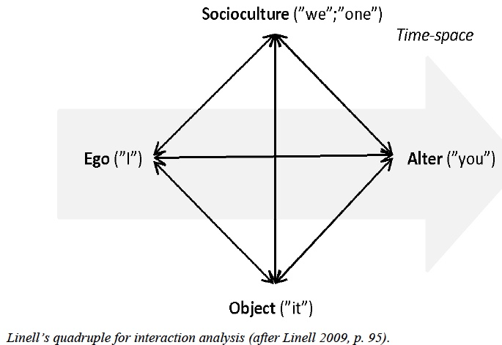
In Bager, 2019: 45
Boje et al 2022 Click Here

Slide 31
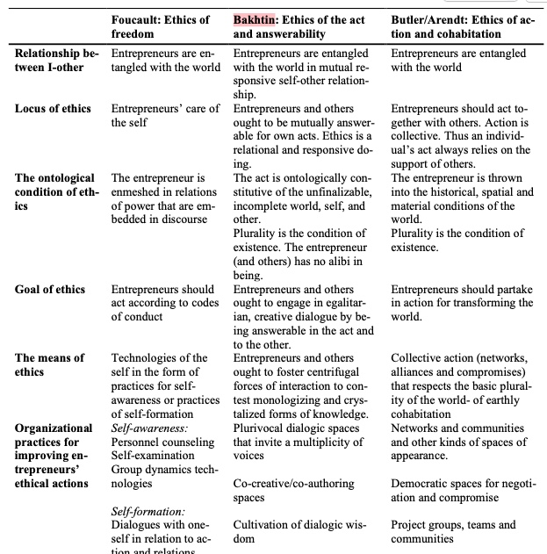
Bager, A. S., Svane, M., & Jørgensen, K. M. (2018). Ethics perspective on entrepreneurship. In The Palgrave handbook of multidisciplinary perspectives on entrepreneurship (pp. 457-477). Palgrave Macmillan, Cham. (download @ Research Gate)

Slide 32
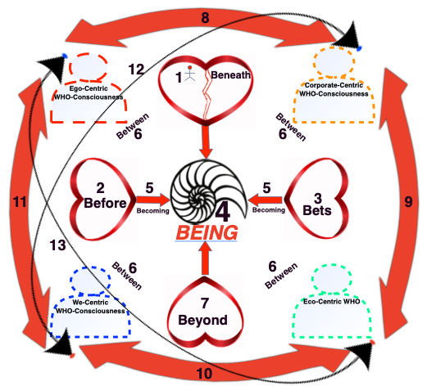
Boje et al 2022 Click Here

Slide 33
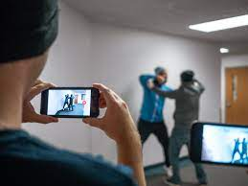
Digital Answerability
To Intervene or Take a Picture
What will you do?

Slide 34

At the heart of this approach
Centrality of emotion-volitional compellentness in lived time and livable space of participative thinking
Not some abstract universal possibility of our participation from a theoretical, qualitative, or mathematical time and space standpoint

Slide 35
Part III
Working with Anete Mikkala Camille Strand
Dissertation advisor: Strand, A. M. C. (2012). Enacting the Between: On dis/continuous intra-active becoming of/through an Apparatus of Material Storytelling. Book 1: Posing (an Apparatus of) Material Storytelling as discontinuous intra-active rework of organizational practices. (Click Here Vol 1) (Click Here Vol 2)
Jorgensen, K., Strand, A., & Boje, D. (2013). Towards a postcolonial-storytelling theory of management and organization. Philosophy of Management, 12(1), 43-66. (click here)
Jørgensen, K. M., & Strand, A. M. C. (2014). Material storytelling–learning as intra-active becoming. Critical narrative inquiry–storytelling, sustainability and power, 53-72. (click here)
Jørgensen, K. M., Strand, A. M. C., Hayden, J., Sparre, M., & Larsen, J. (2021). Down to earth: Gaia storytelling and the learning organization. The Learning Organization. (click here)

Slide 36
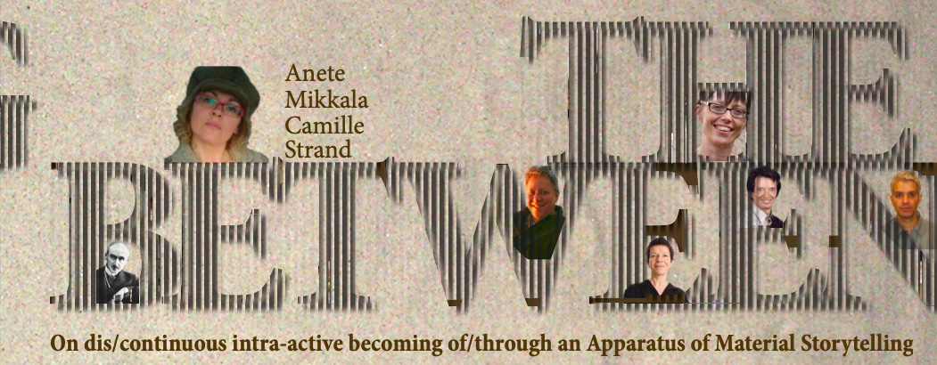
The Cover: Enacting the Between …

Slide 37
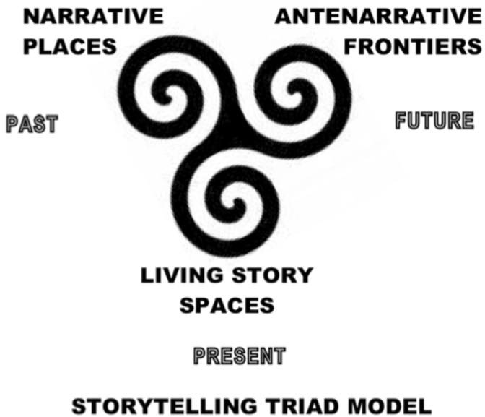
Strand Dissertation p. 140

Slide 38
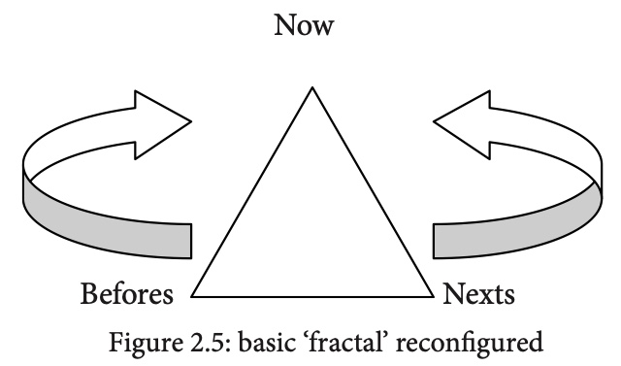
How fractal relates to hearts
Strand 2012: diagram 107 & p. 108 Bersanian Durée

Slide 39
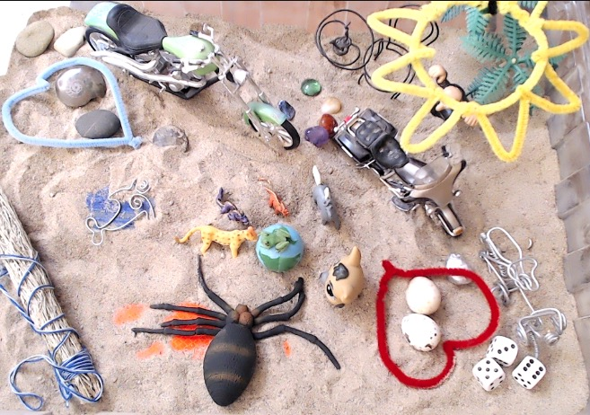
Click for study guide
We use practices of material artifacts in sandtrays, storytelling circles, and conversational interview methods as we trace a groups of participants for months and years as they engage participative thinking navigations in making sustainable choices or shying away from participative action in their respective locales

Slide 40
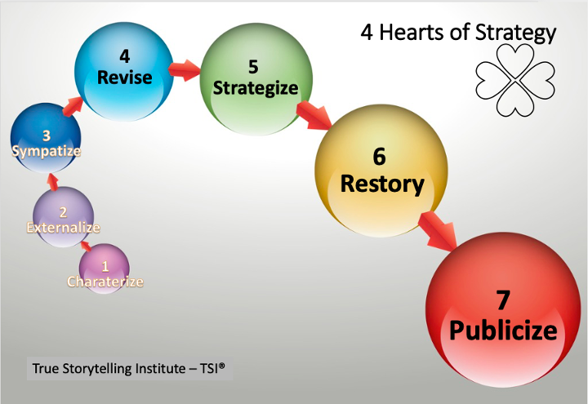
Embodied Restorying Process

Slide 41
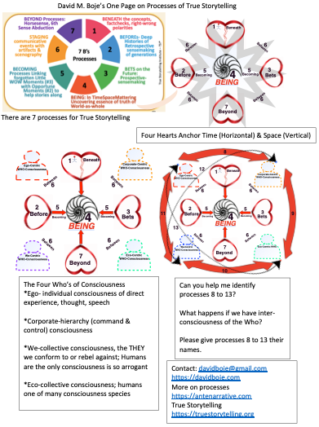
Click for study guide
Click for 2022 article on 4 hears and Tamara-Land

Slide 42
Bakhtin meets Enthinkment Circle - YouTube (filmed May 15, posted May 17 2022)
Thank you for the conversations
For more on Enthinkment Circle visit Enthinkment.com
More on Antenarrative Processes, visit Antenarrative.com
Boje’s Home site DavidBoje.com
Bakhtin meets Enthinkment Circle - YouTube (filmed before seminar - May 15, posted May 17 2022

